Slide 1
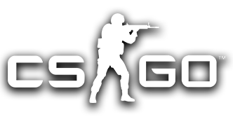

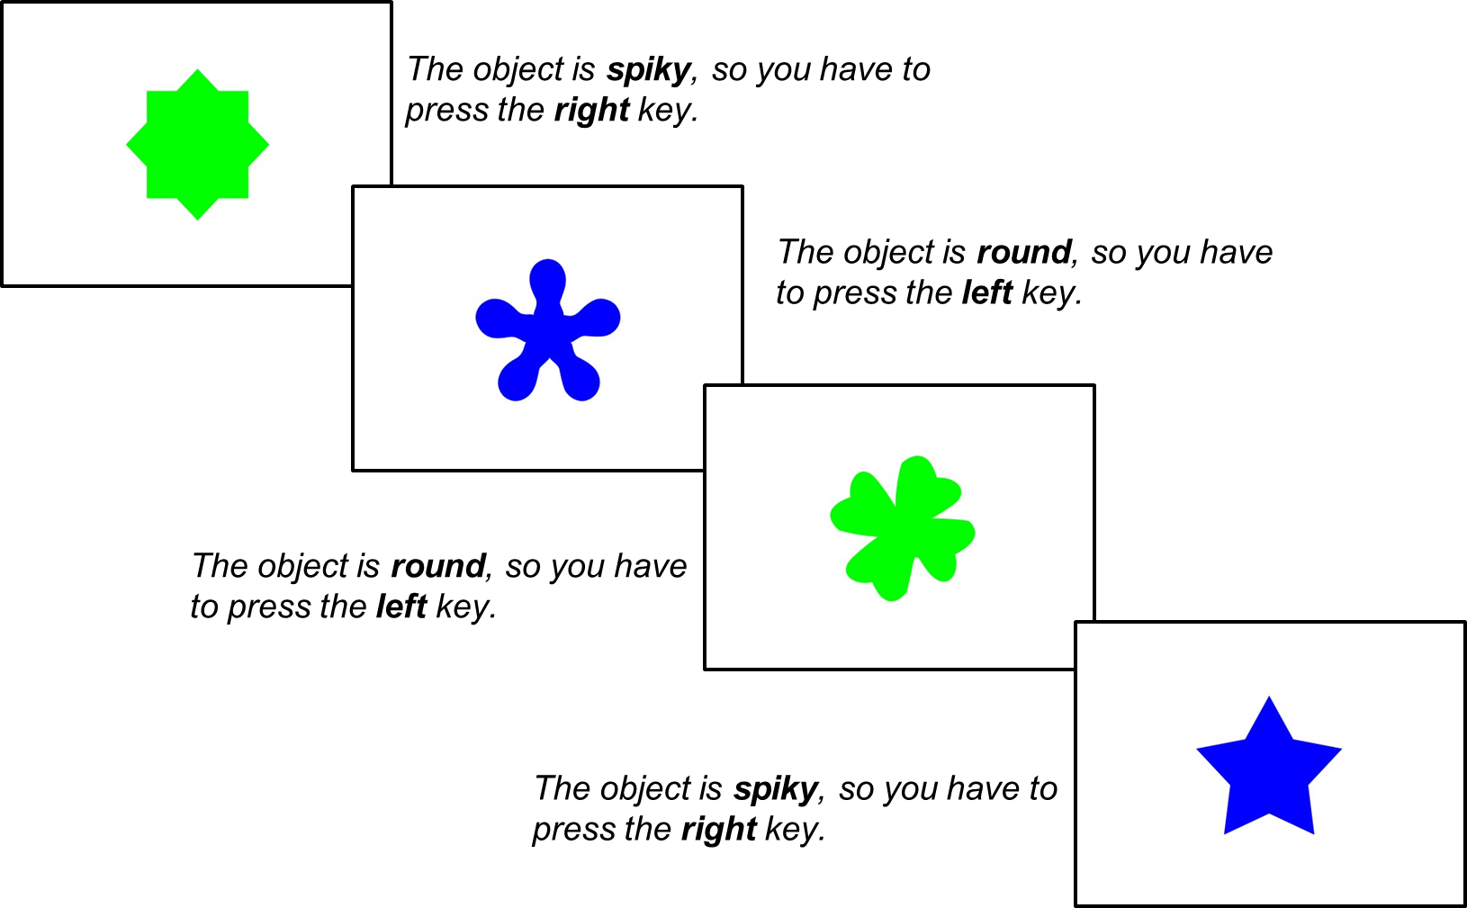
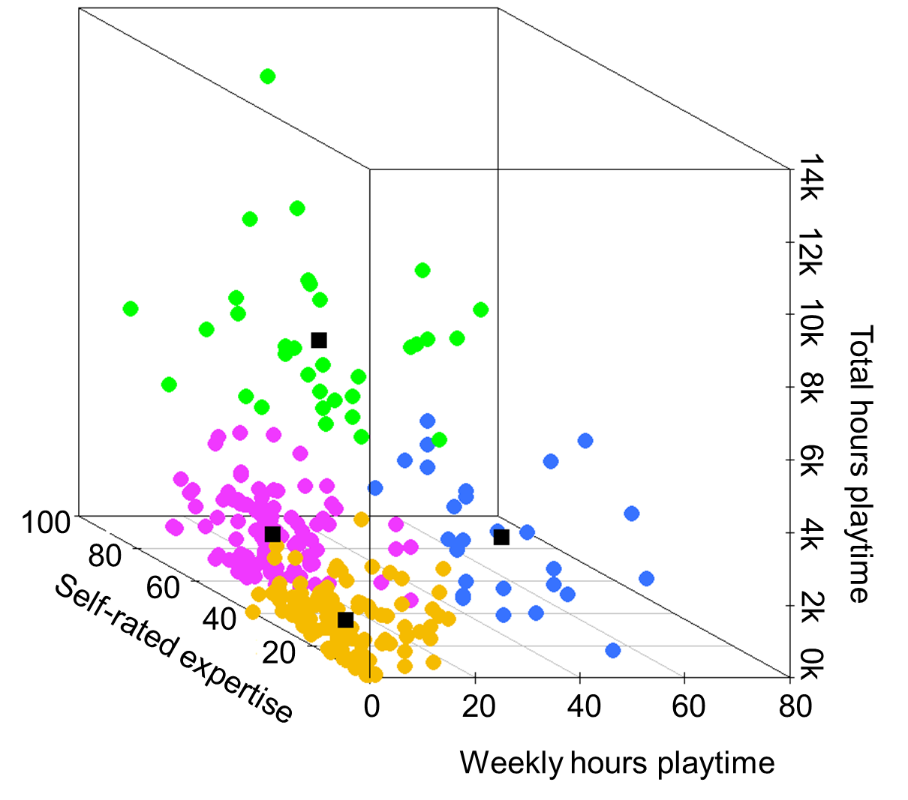
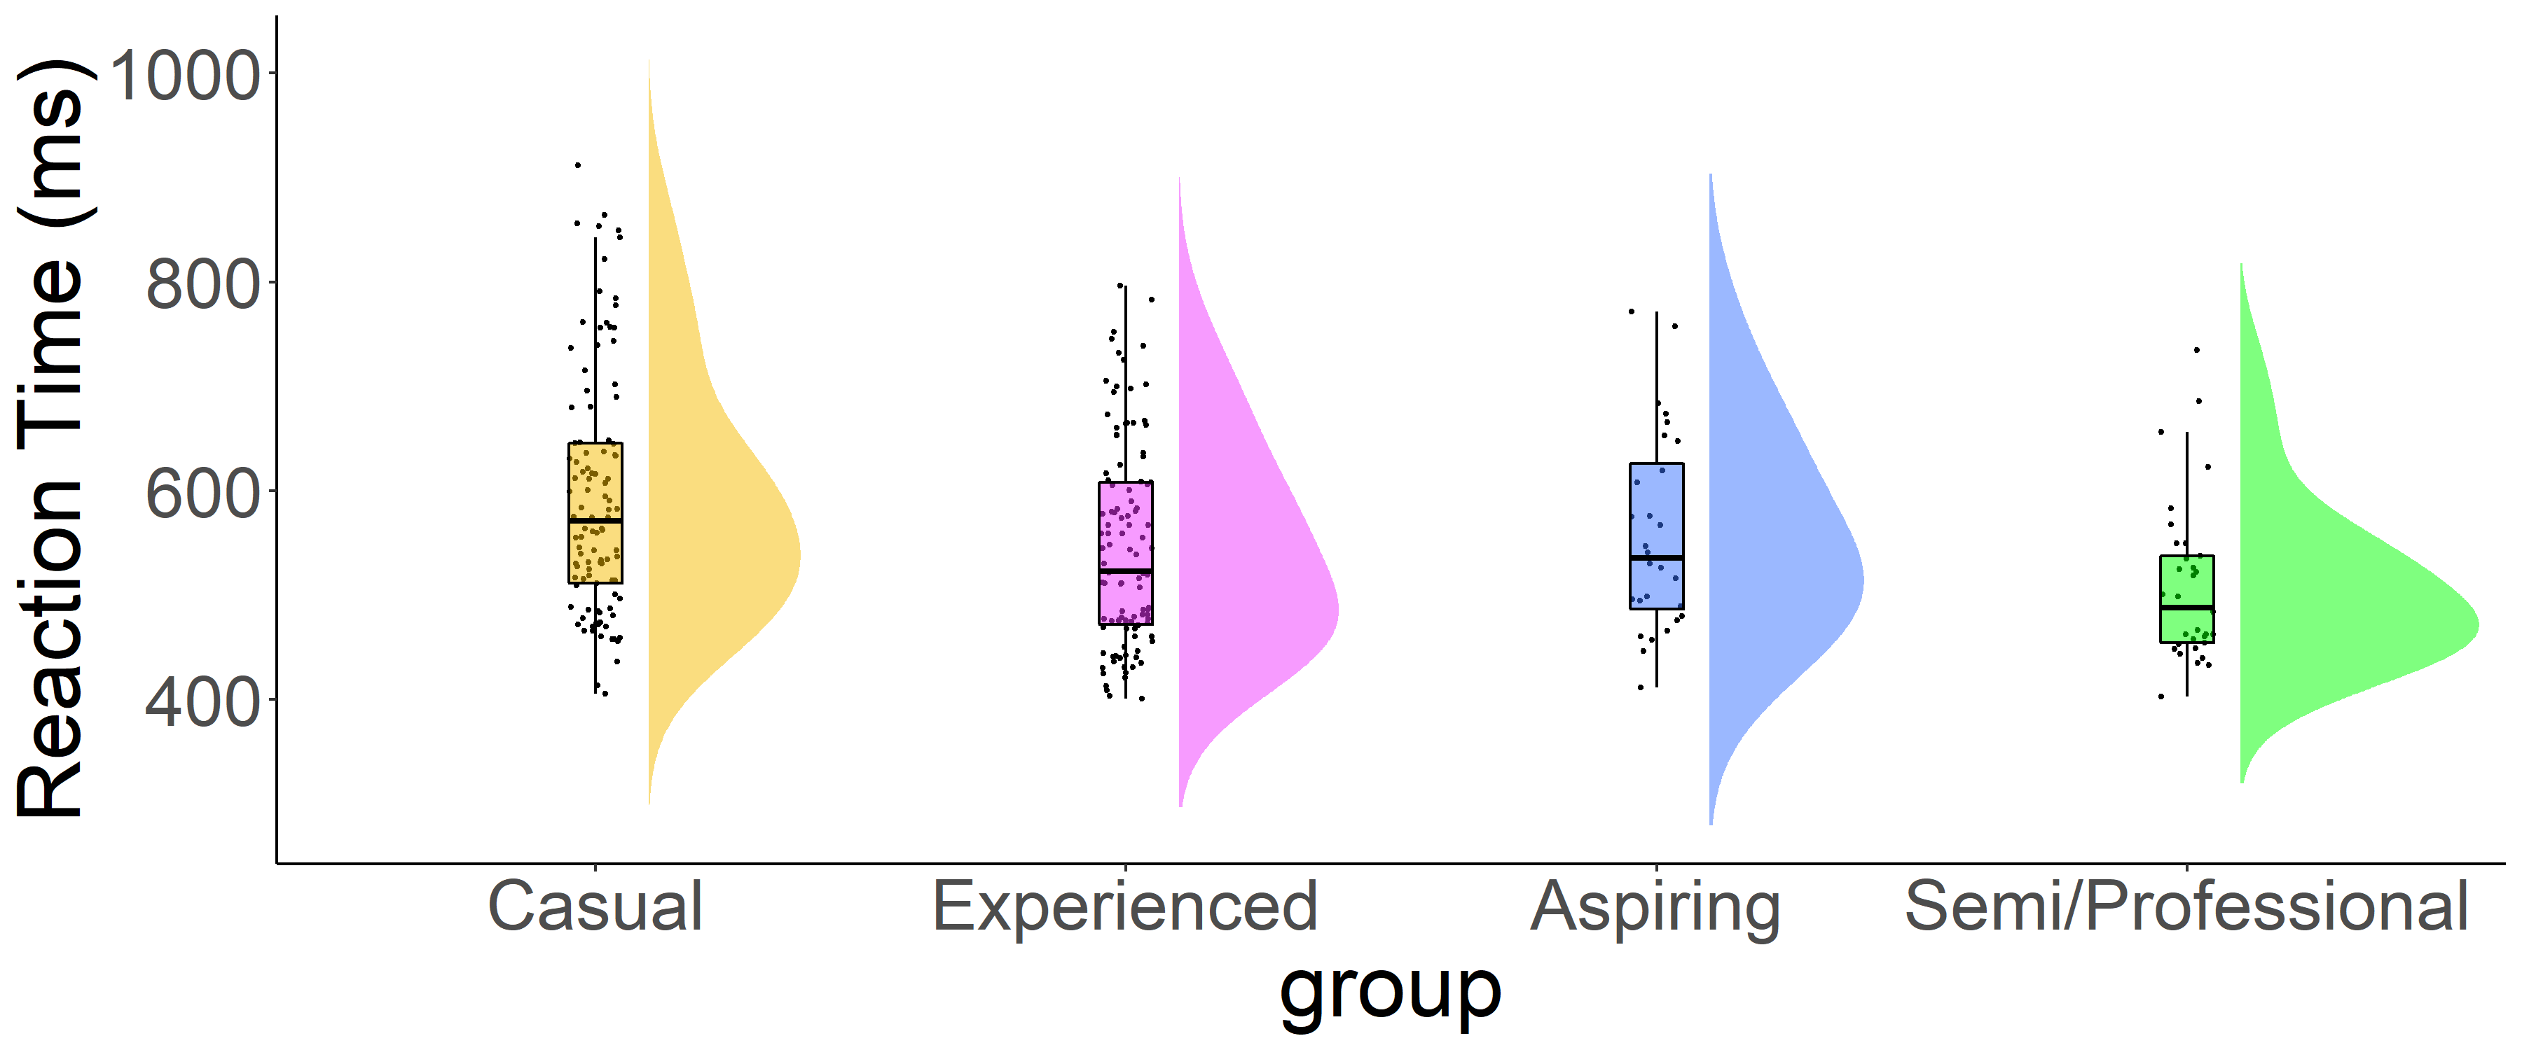
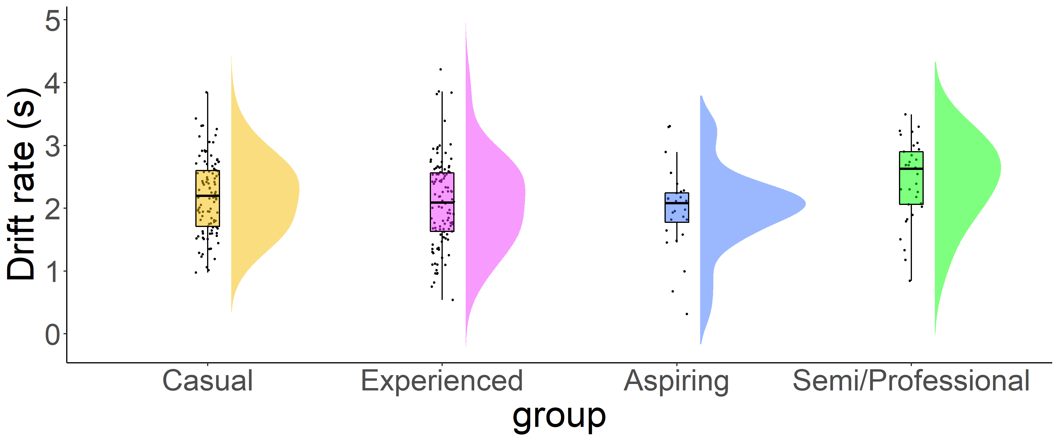

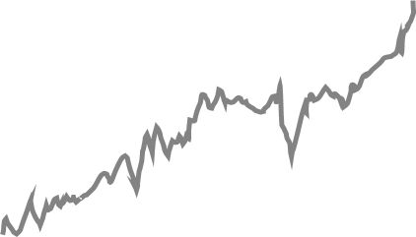
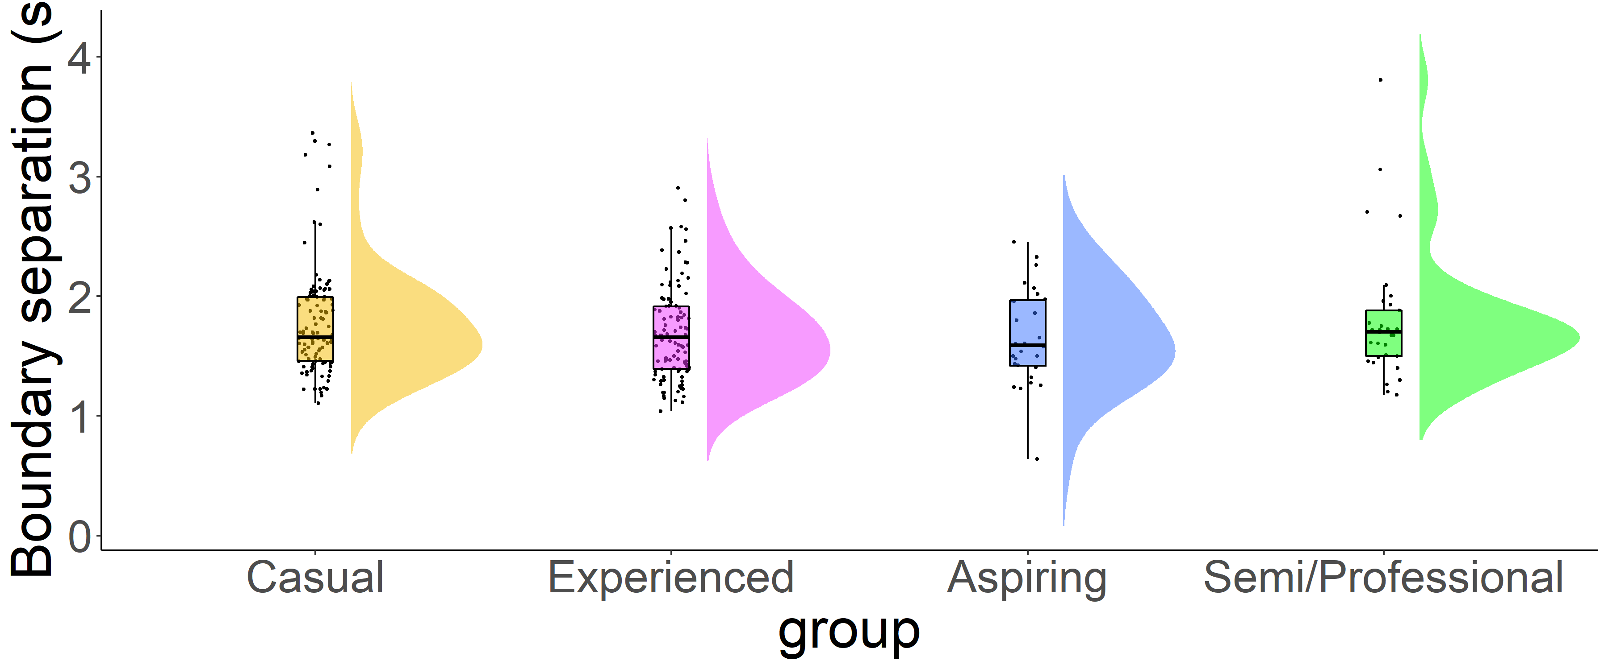
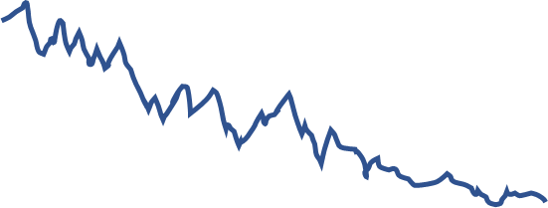
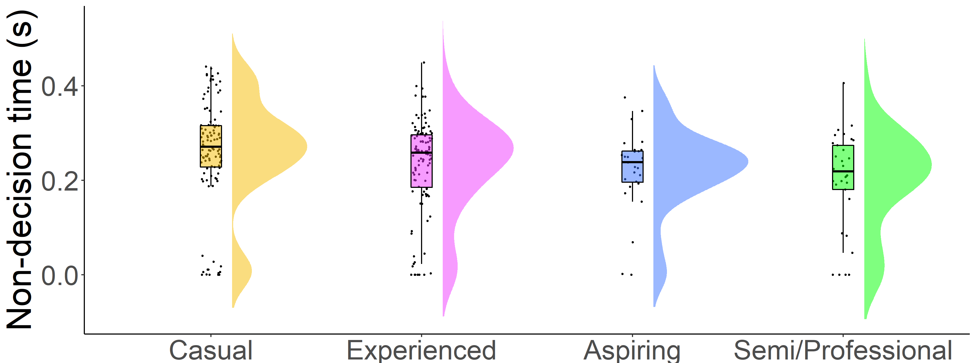


4023
Cognitive Correlates of Action Video Gaming: A Cross-sectional Study
of Habitual and Professional Counter-Strike Players
Eleanor R. A. Hyde and Dr Claudia C. von Bastian
The University of Sheffield, UK.
Background
Method
Results
Playing Action Video Games (AVGs) has been shown to have the potential to enhance information processing, especially in highly skilled AVG players who have experienced hundreds of hours of gameplay.
However, AVG training studies yield mixed results. Previous research² has found AVG training to decrease reaction times (RTs) whilst others³ found no such effect.
By decomposing RTs using the drift-diffusion model (DDM), researchers¹ found AVG training to improve drift rates whilst others³ found AVG training to increase boundary separations.
These mixed results may be due to some methodological limitations such as short training periods, small samples and practice effects that the present study attempts to address.
Fig.1. Choice RT Task
Fig.3. K-means Clusters
Fig.4 Processing speed
p=.001
Fig.5 Drift rate
p=.088
Fig.2. Drift-diffusion model graph
Correct response
Fig.7 Boundary separation
p=.603
Starting point
Boundary Separation
NB: one extreme value cropped from the plot for clarity
Fig.6 Non-decision time
Drift rate
p=.024
Research Questions
Incorrect response
NB: four extreme values cropped from the plot for clarity
How should AVG expertise be measured?
Is greater AVG expertise associated with enhanced processing speed and decision-making?
Scan for extra figures and more!
Stimulus encoding
Decision time
Response execution
Method
Conclusions
Study 1
Study 2
Interviews with casual, expert and professional Counter-Strike (CS) players (N=3) to establish measures of expertise.
1. Questionnaire: measured CS expertise.
Study 2
2. Choice RT task: decide if a shape is round or spiky, or whether it is green or blue.
Interview questions informed by the Questionnaire from Study 2.
Online cross-sectional study with habitual and professional CS players (N=273).
Measured RT distribution and accuracy.
Total hours playtime, weekly hours playtime, self-rated expertise, current ranking, tournament participation, role.
AVG players with the highest level of expertise showed faster overall processing speed in a Choice RT task. DDM suggests these differences are mainly due to their faster non-decision times and (although non-significant) higher drift rates.
These results support findings from previous literature. However, further intervention research is necessary to causally determine the relationship between AVG play, processing speed and decision-making.
1. Dye, M. W. G., Green, C. S., & Bavelier, D. (2009). Increasing speed of processing with Action Video Games. Current Directions in Psychological Science, 18(6), 321–326. doi:10.1111/j.1467-8721.2009.01660
2. Green, C. S., Pouget, A., Bavelier, D. (2010). Improved probabilistic inference as a general learning mechanism with action video games. Current Biology, 20(17), 1573–1579. doi:10.1016/j.cub.2010.07.040
3. Van Ravenzwaaij, D., Boekel, W., Forstmann, B. U., Ratcliff, R., & Wagenmakers, E. J. (2014). Action video games do not improve the speed of information processing in simple perceptual tasks. Journal of Experimental Psychology: General, 143(5), 1794–1805. doi:10.1037/a0036923

